Slide 1


The Azure NoSQL Evolution: Azure Table Storage vs. Azure Cosmos DB
Sirar Salih
Solution Architect at Making Waves

Slide 2











Manage Stakeholders
Who Am I?
Balancing stakeholder influence and customer needs
Hydro is a global enterprise, with many different business stakeholders and content owners who have different needs and priorities.
Finding a good balance between corporate consistency and local business relevance while not falling into the trap of designing according to internal organisation rather than the customer can be challenging.
Sirar Salih
Solution Architect at Making Waves
Credit:

Slide 3
2019

Slide 4
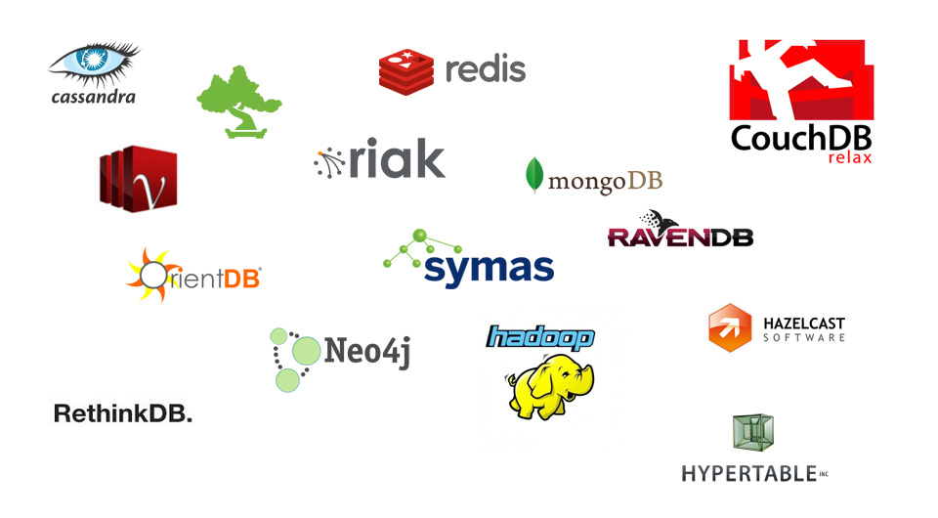








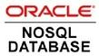




Slide 5
Each NoSQL database has its good and bad side.

Slide 6

Azure Table Storage

Slide 7



Pros
Easy setup
Cheap
Minimal work required
Easy to understand
Simple model: Entity, PartitionKey, RowKey

Slide 8
Cons
Low on scalability
Lack of basic database operations
- No «like» or «contains»
No backup procedure

Slide 9
Setup & usage

Slide 10
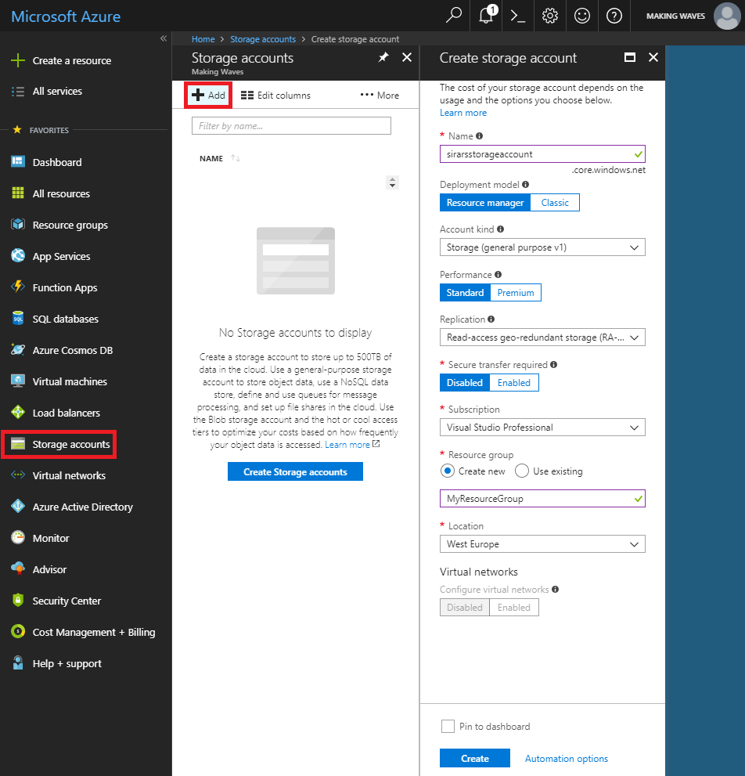
https://portal.azure.com
Storage accounts
Add

Slide 11
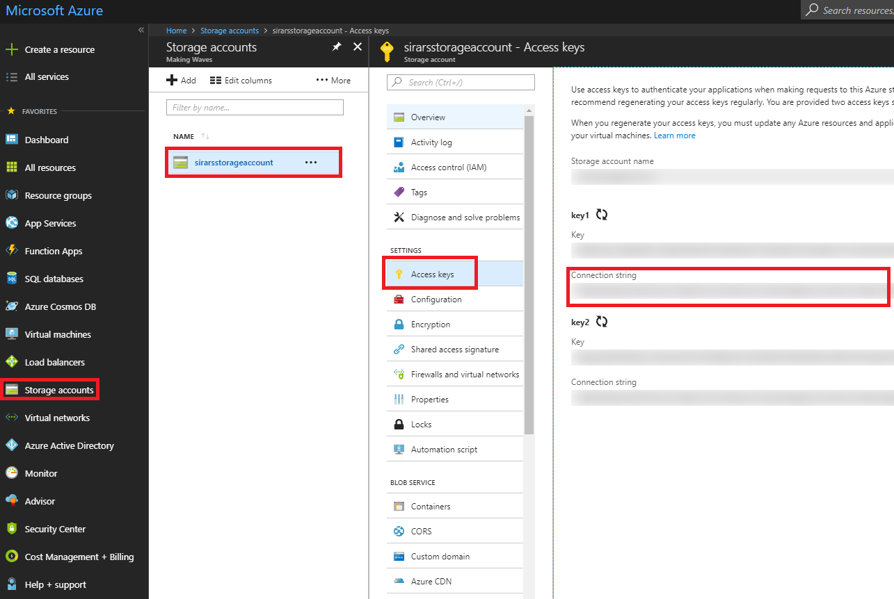
https://portal.azure.com
Storage accounts
Select storage account
Access keys
Connection string

Slide 12
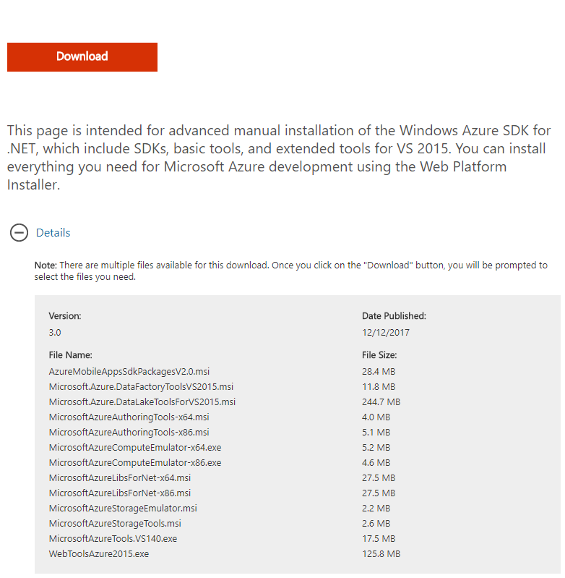
Azure SDK

Slide 13
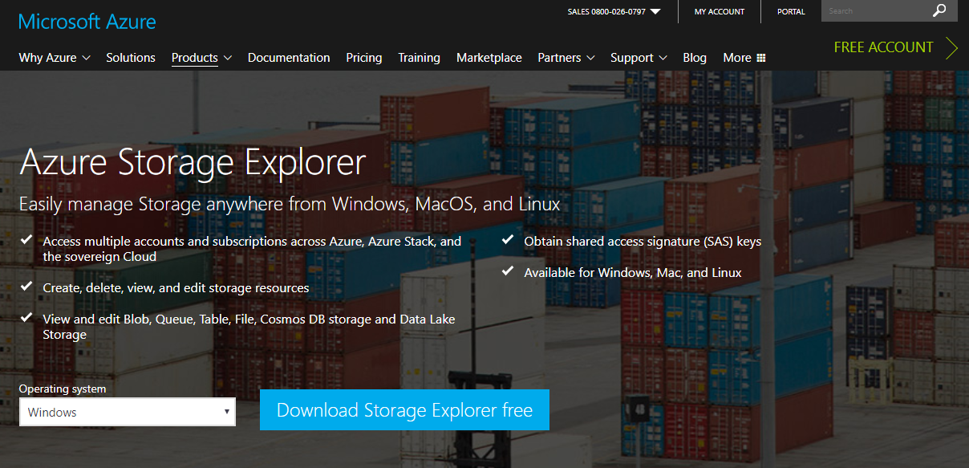
Azure Storage Explorer

Slide 14
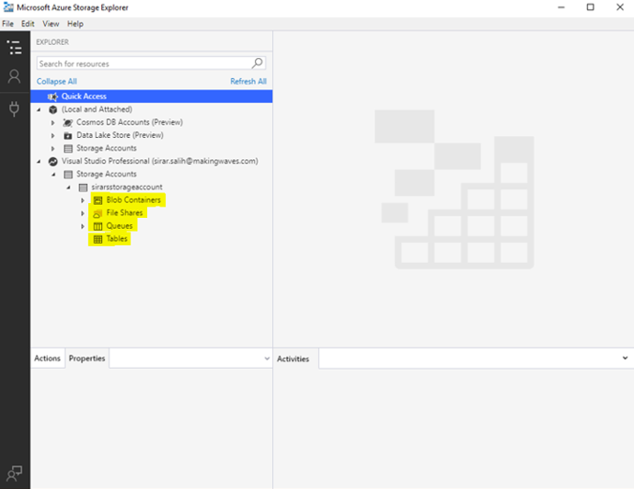
Azure Storage Explorer

Slide 15
Connect and create table
private const string tableName = "Customers";
private static CloudTable _cloudTable;
public TableStorageService(KeyVaultSecretProvider keyVaultSecretProvider, string storageAccountName, string storageAccountKeyName)
{
var storageAccountKey = keyVaultSecretProvider.GetSecret(storageAccountKeyName);
var connectionString = $"DefaultEndpointsProtocol=https;AccountName={storageAccountName};AccountKey={storageAccountKey};EndpointSuffix=core.windows.net";
var cloudStorageAccount = CloudStorageAccount.Parse(connectionString);
var cloudTableClient = cloudStorageAccount.CreateCloudTableClient();
_cloudTable = cloudTableClient.GetTableReference(tableName);
}

Slide 16
Entity
public class CustomerEntity : TableEntity
{
public CustomerEntity() { }
public CustomerEntity(string lastName, string firstName)
{
PartitionKey = lastName;
RowKey = firstName;
}
}

Slide 17
Insert entity
var insertOperation = TableOperation.Insert(new CustomerEntity("Snow", "Jon"));
await _cloudTable.ExecuteAsync(insertOperation);

Slide 18
Batch insert entities
var tableBatchOperation = new TableBatchOperation();
for(var i = 0; i < 100; i++)
{
tableBatchOperation.Insert(new CustomerEntity("Snow", $"Jon {i}"));
if(i == 99) {
await _cloudTable.ExecuteBatchAsync(tableBatchOperation);
}
}

Slide 19
Get entity
var query = new TableQuery<CustomerEntity>()
.Where(TableQuery.GenerateFilterCondition("RowKey", QueryComparisons.Equal, "Jon"));
_cloudTable.ExecuteQuery(query);

Slide 20
Delete entity
var retrieveOperation = TableOperation.Retrieve<CustomerEntity>("Snow", "Jon");
var retrievedResult = await _cloudTable.ExecuteAsync(retrieveOperation);
var deleteEntity = (CustomerEntity)retrievedResult.Result;
var deleteOperation = TableOperation.Delete(deleteEntity);
await _cloudTable.ExecuteAsync(deleteOperation);

Slide 21
Blob containers
Blob container: Similar to a folder, containing a collection of blobs
Blob: A file of any format

Slide 22
Connect and create blob container
private const string CustomersContainerName = "customers";
private static CloudBlobContainer _cloudBlobContainer;
public Job(string connectionString)
{
var cloudStorageAccount = CloudStorageAccount.Parse(connectionString);
var cloudBlobClient = cloudStorageAccount.CreateCloudBlobClient();
_cloudBlobContainer = cloudBlobClient.GetContainerReference(CustomersContainerName);
if (!_cloudBlobContainer.Exists()) _cloudBlobContainer.Create();
}

Slide 23
Upload blob
var cloudBlockBlob = _cloudBlobContainer.GetBlockBlobReference(blobName);
cloudBlockBlob.Properties.ContentType = "application/json";
using (var ms = new MemoryStream())
{
var j = JsonConvert.SerializeObject(json);
var writer = new StreamWriter(ms); writer.Write(j);
writer.Flush();
ms.Position = 0;
cloudBlockBlob.UploadFromStream(ms);
}

Slide 24
Download blob
var cloudBlockBlob = _cloudBlobContainer.GetBlockBlobReference(blobName);
await cloudBlockBlob.DownloadToFileAsync("C:\Documents\customer.json", FileMode.Create);

Slide 25
Delete blob
var cloudBlockBlob = _cloudBlobContainer.GetBlockBlobReference(blobName);
await cloudBlockBlob.DeleteIfExistsAsync();

Slide 26
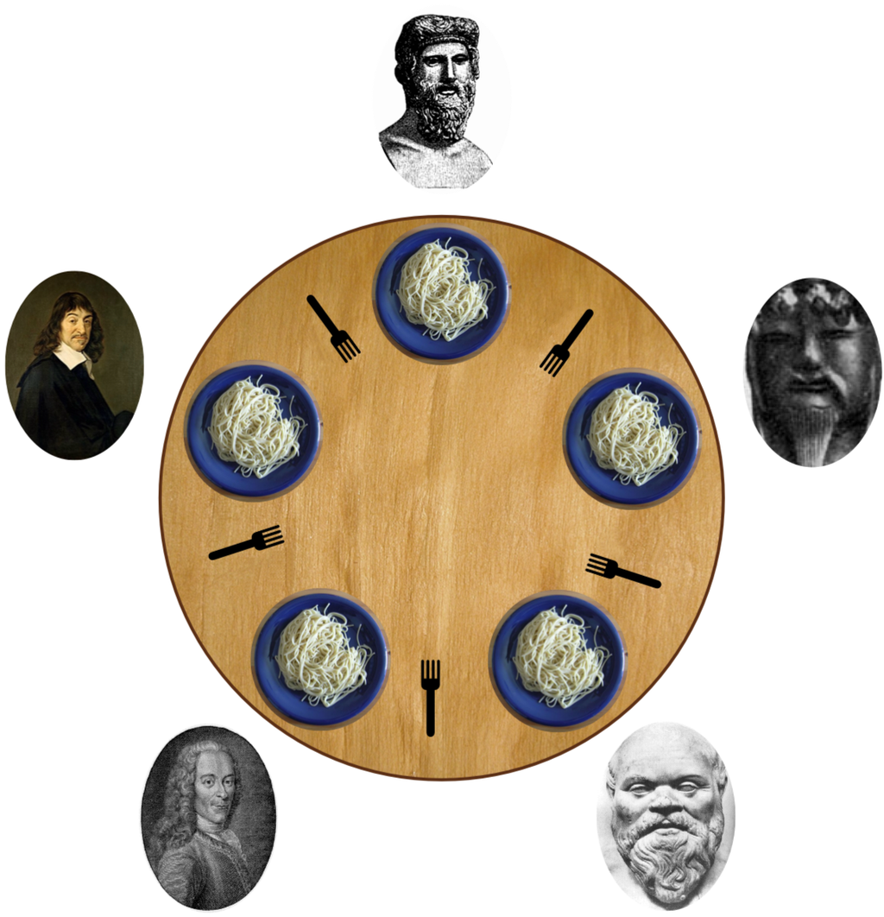
Concurrency

Slide 27
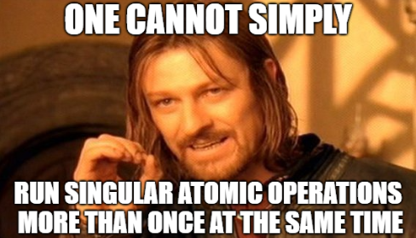

Slide 28
Blob leasing

Slide 29
Blob leasing
Create a blob container (one time operation)
Create a blob (one time operation)
Lease the blob
Do table storage operations
Renew the lease on blob if not yet done, or release the lease on blob if done
Go to step 3
https://sirarsalih.com/2018/04/03/a-blob-leasing-strategy-to-handle-concurrent-webjob-runs/

Slide 30
Queues
Provide asynchronous cloud messaging between application components
A service for storing messages that can be accessed from anywhere
Single queue message up to 64 KB in size
Queue can contain millions of messages

Slide 31
Connect and create queue
private const string queueName = "queue";
private static CloudQueue _cloudQueue;
public Job(string connectionString)
{
var cloudStorageAccount = CloudStorageAccount.Parse(connectionString);
var cloudQueueClient = cloudStorageAccount.CreateCloudQueueClient();
_cloudQueue = cloudQueueClient.GetQueueReference(queueName);
_cloudQueue.CreateIfNotExists();
}

Slide 32
Insert message
var cloudQueueMessage = new CloudQueueMessage("Hello, Jon Snow!");
await _cloudQueue.AddMessageAsync(cloudQueueMessage);

Slide 33
Peek at message
var cloudQueueMessage = await _cloudQueue.PeekMessageAsync();
Console.WriteLine(cloudQueueMessage.AsString);

Slide 34
Update message content
var cloudQueueMessage = await _cloudQueue.GetMessageAsync();
cloudQueueMessage.SetMessageContent("New content.");
_cloudQueue.UpdateMessage(cloudQueueMessage,
TimeSpan.FromSeconds(60.0),
MessageUpdateFields.Content | MessageUpdateFields.Visibility);

Slide 35
Delete message
var cloudQueueMessage = await _cloudQueue.GetMessageAsync();
await _cloudQueue.DeleteMessageAsync(cloudQueueMessage);

Slide 36
Get number of messages
_cloudQueue.FetchAttributes();
var messageCount = _cloudQueue.ApproximateMessageCount;

Slide 37
File shares
Easy-to-use cloud file system
Upload, download files
Can be mounted in Windows, Linux, and macOS
Snapshots

Slide 38
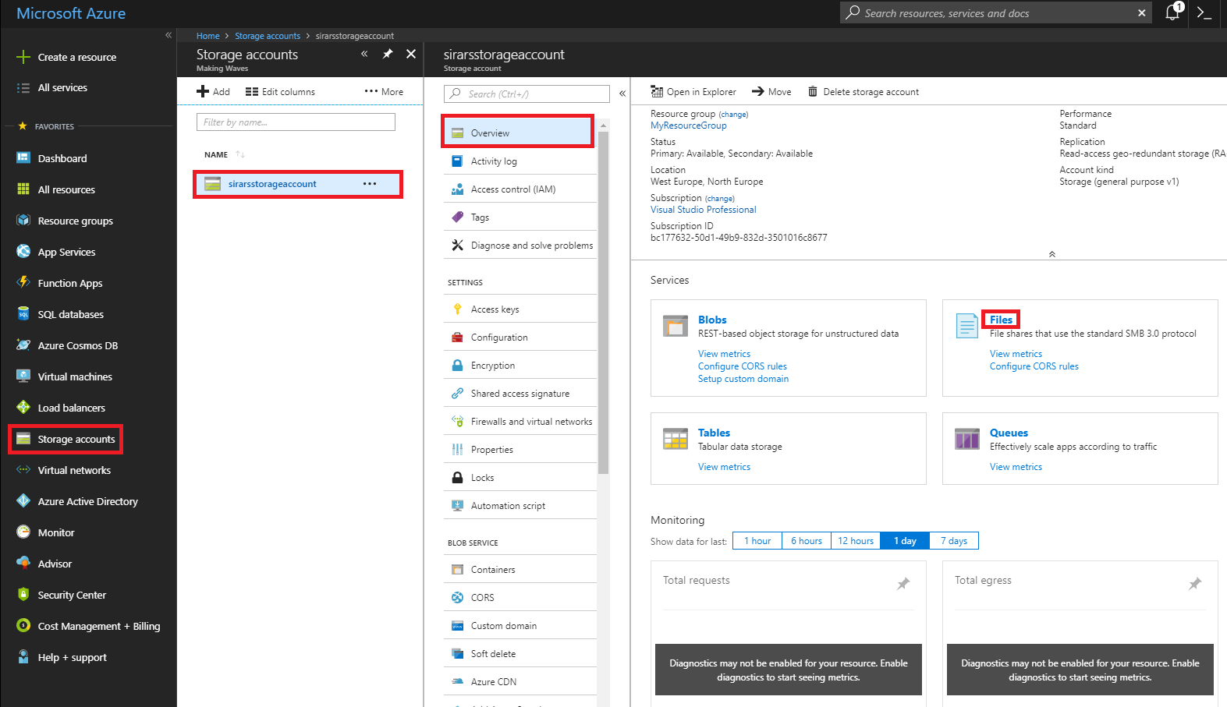
https://portal.azure.com
Storage accounts
Select storage account
Overview
Files

Slide 39
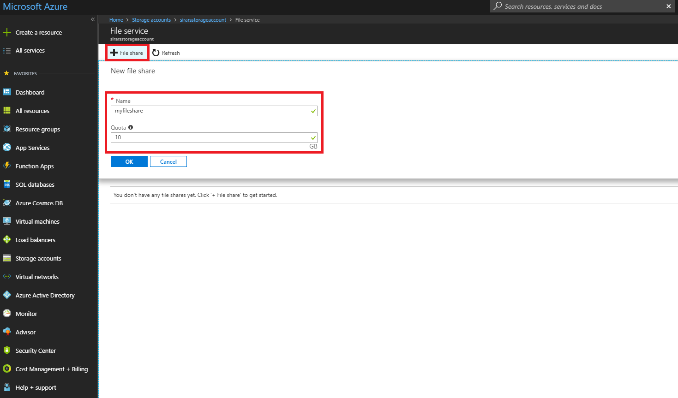
https://portal.azure.com
File share
Name and quota
OK

Slide 40
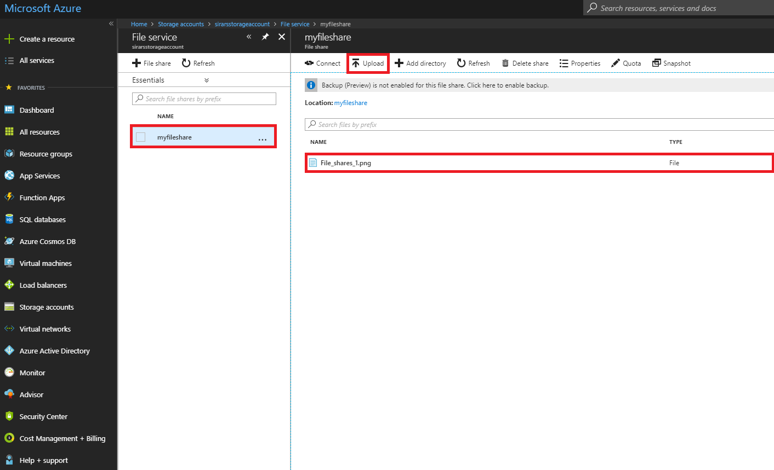
https://portal.azure.com
Select file share
Upload

Slide 41
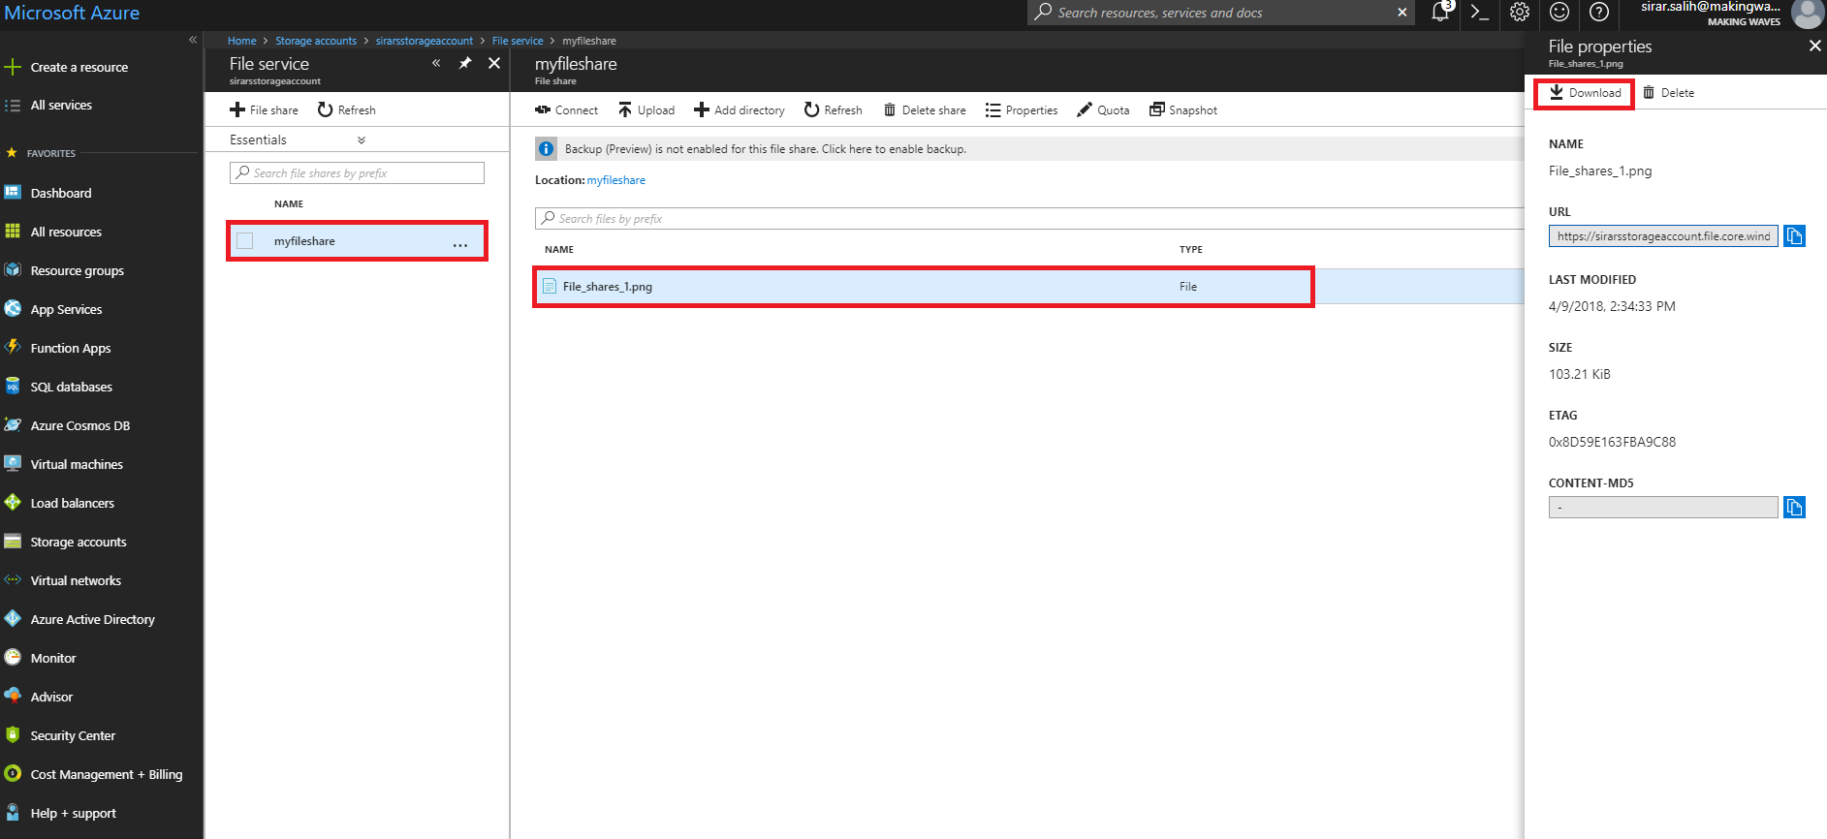
https://portal.azure.com
Select file share
Select file
Download

Slide 42
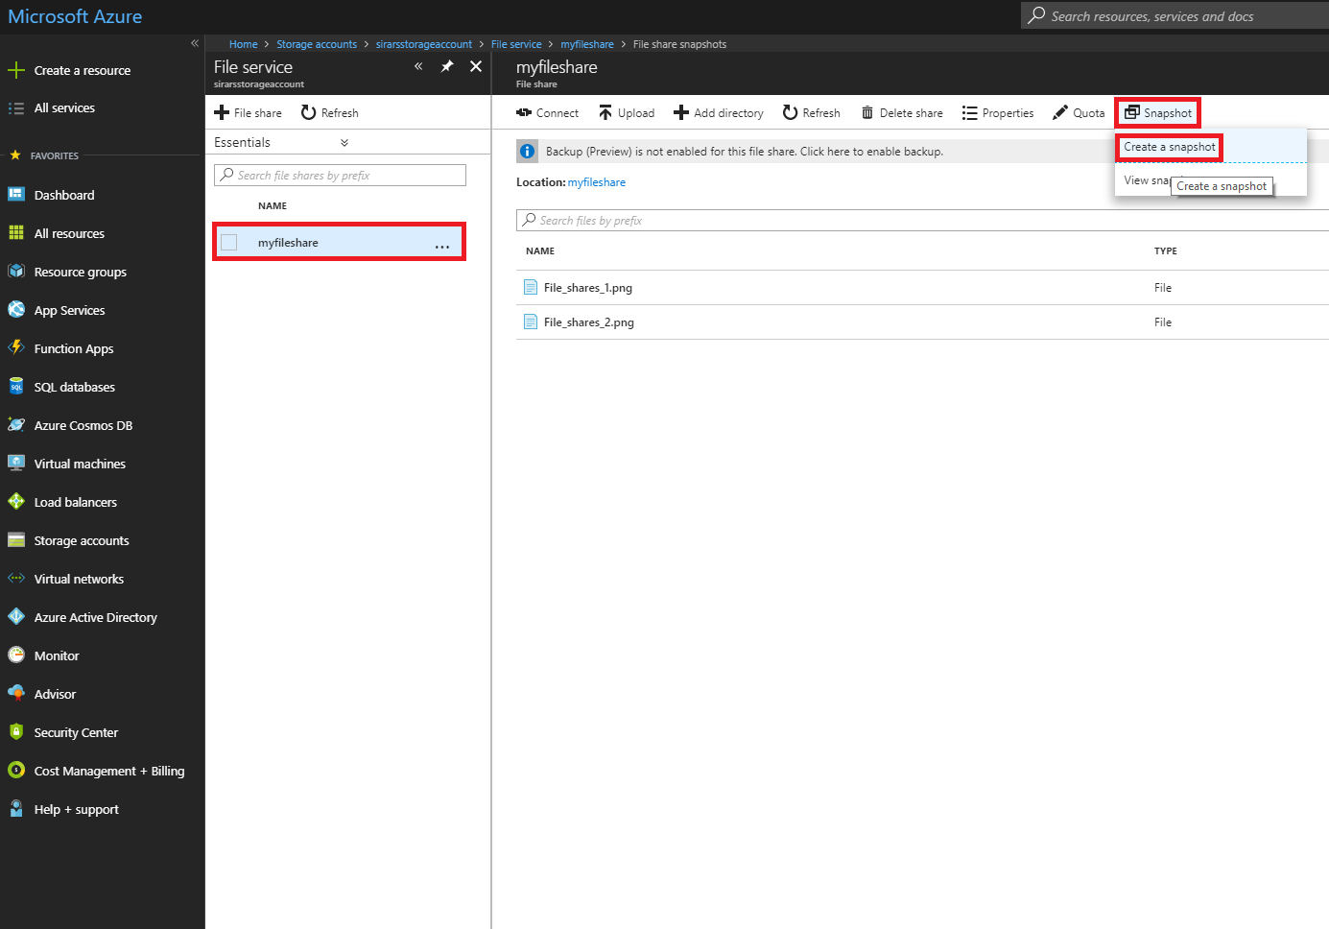
https://portal.azure.com
Select file share
Snapshot
Create a snapshot

Slide 43
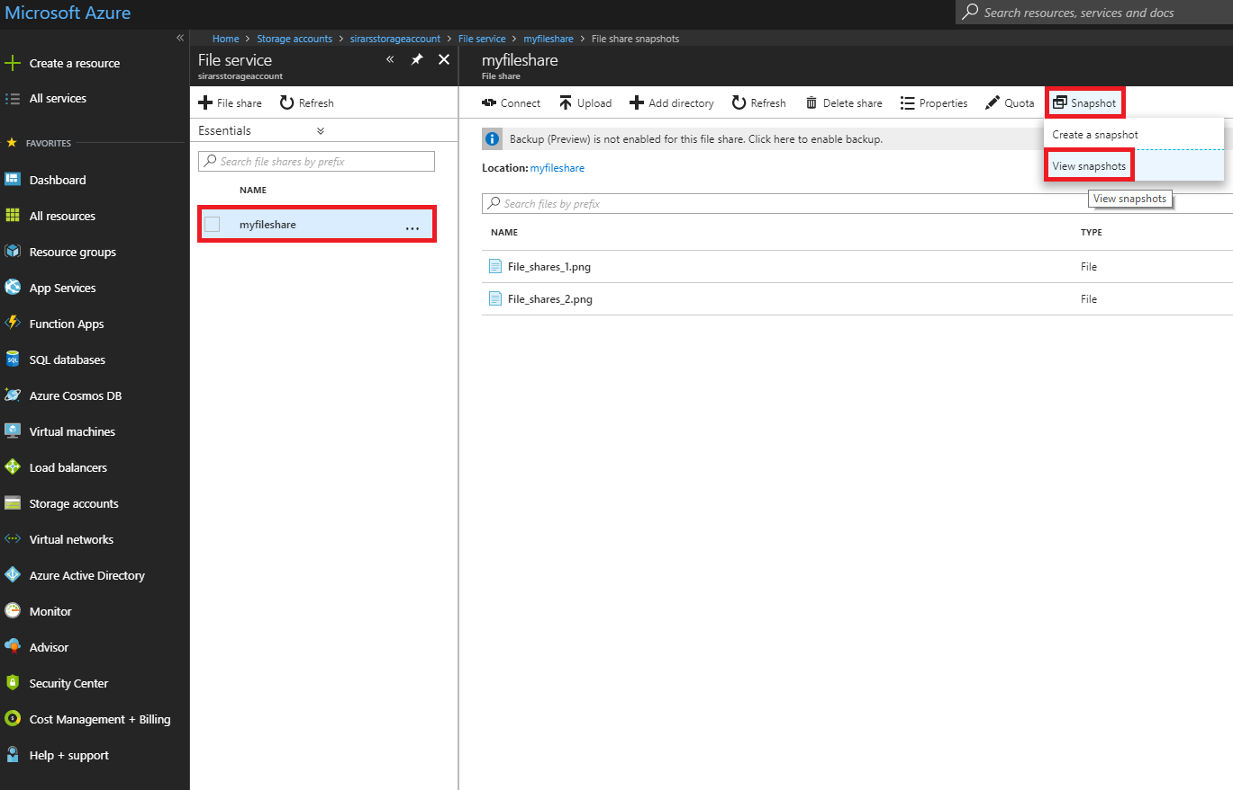
https://portal.azure.com
Select file share
Snapshot
View snapshots

Slide 44
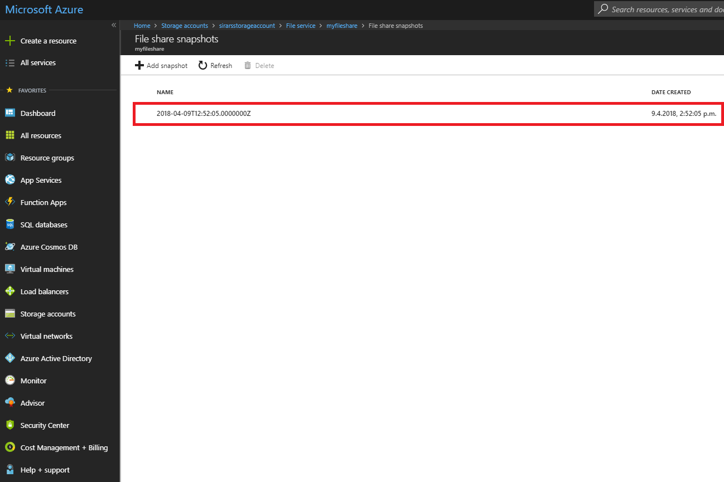
https://portal.azure.com

Slide 45
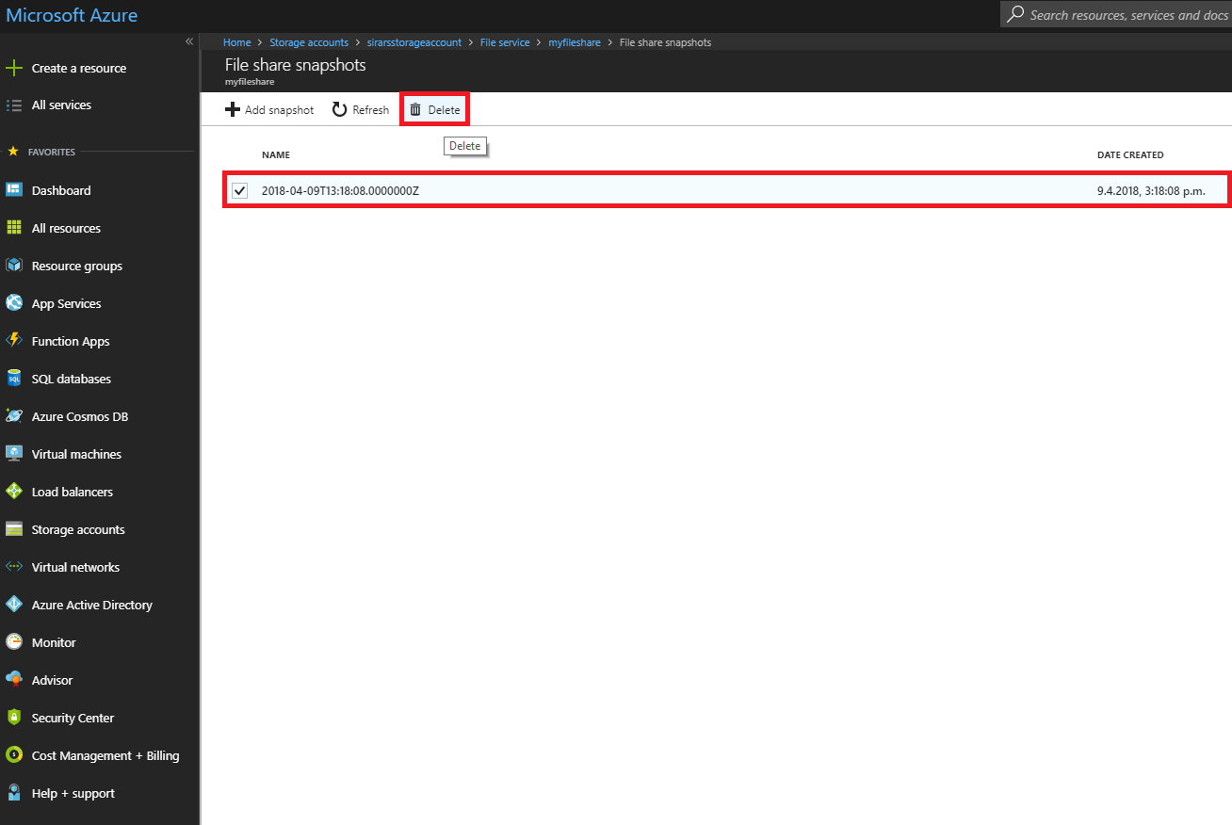
https://portal.azure.com
Select snapshot
Delete

Slide 46
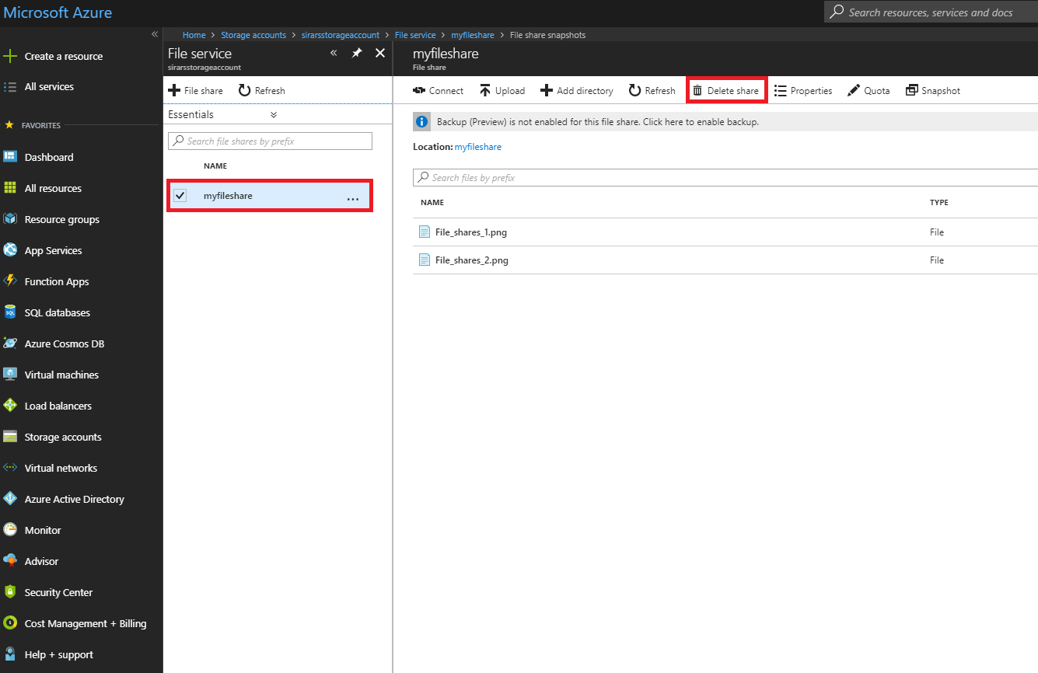
https://portal.azure.com
Select file share
Delete share

Slide 47
Performance

Slide 48
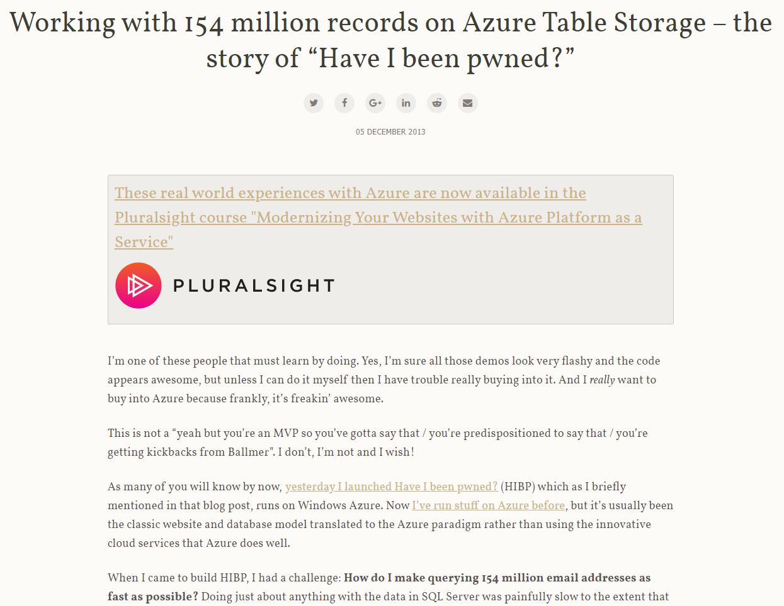
Troy Hunt
Credit: https://www.troyhunt.com, Troy Hunt.

Slide 49
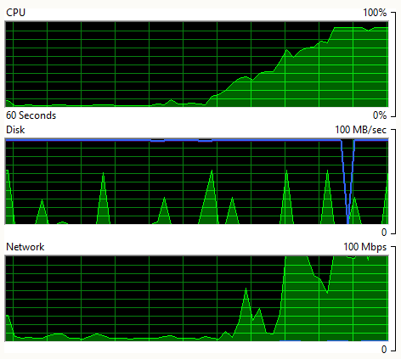
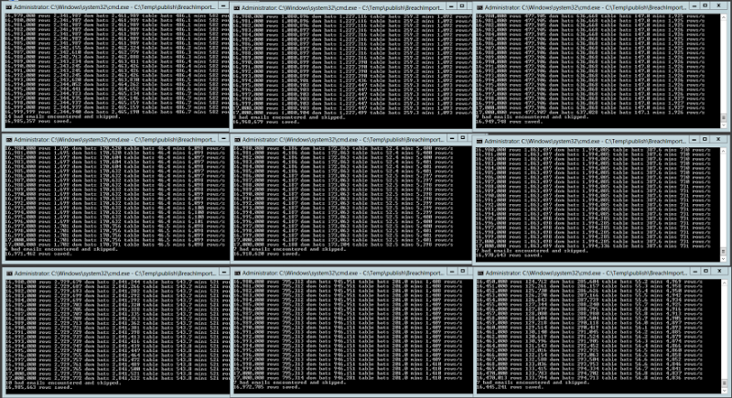
Troy Hunt
9 simultaneous importers
Total average speed at 22 500 inserts pr. second
Credit: https://www.troyhunt.com, Troy Hunt.
Credit: https://www.troyhunt.com, Troy Hunt.

Slide 50
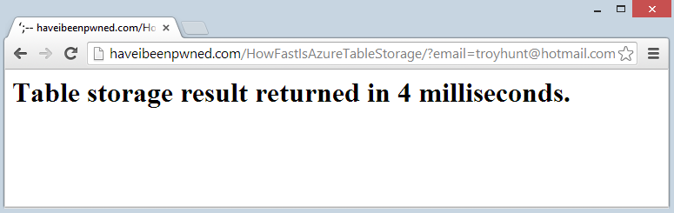
Troy Hunt
http://haveibeenpwned.com/HowFastIsAzureTableStorage/?email=troyhunt@hotmail.com
A query of 154 million records returns result in 4 milliseconds
Credit: https://www.troyhunt.com, Troy Hunt.

Slide 51
vs

Slide 52

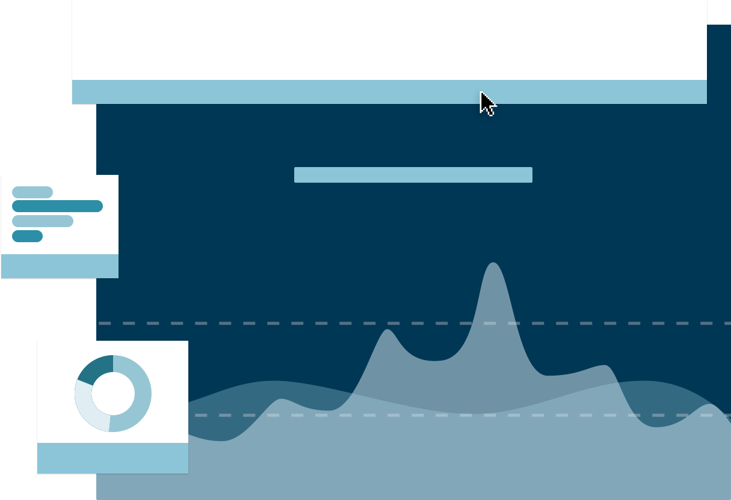
vs
Some similarities
Table storage lacks backup procedure, while CosmosDB has it
Table storage has storage-based pricing, while CosmosDB has throughput-based
Table storage is aimed at high capacity on a single region, while CosmosDB aims at global distribution, high throughput
Choosing which depends on different scenarios

Slide 53
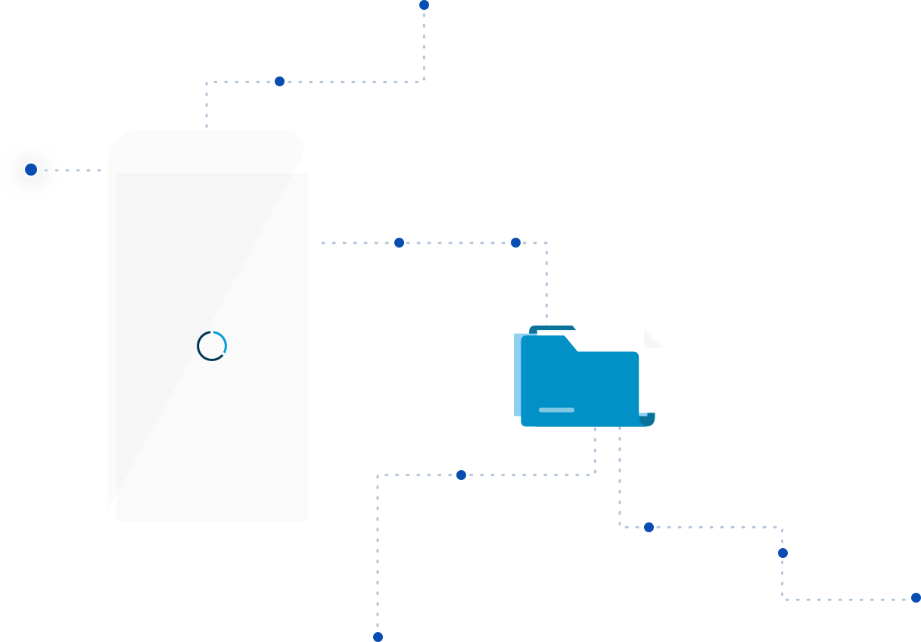
Mobile apps
A good choice for mobile apps
But Azure Easy Tables is better
- An app service
- Backed by Azure SQL and geared towards mobile apps

Slide 54
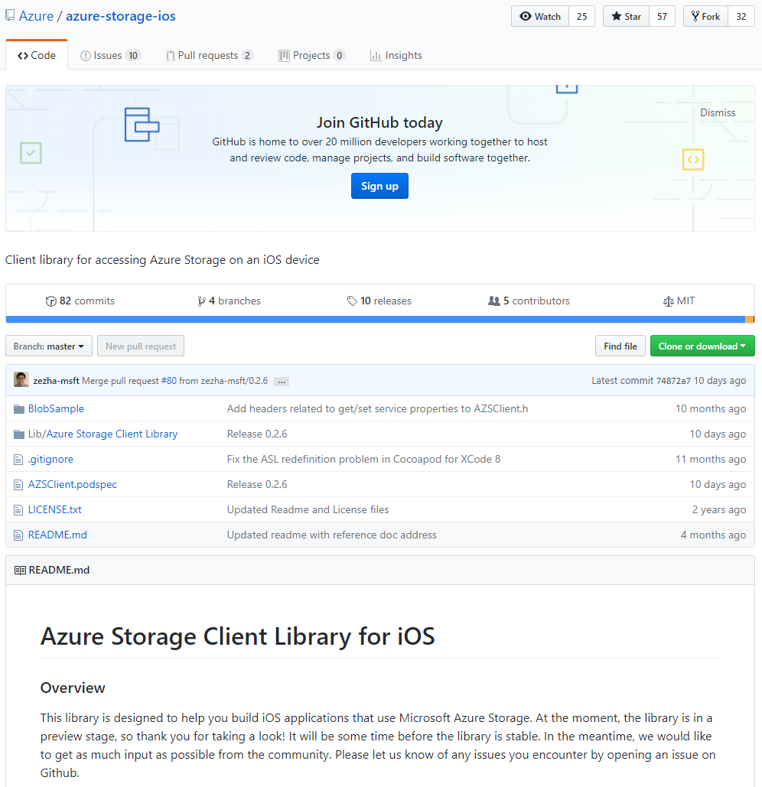
https://github.com/Azure/azure-storage-ios

Slide 55
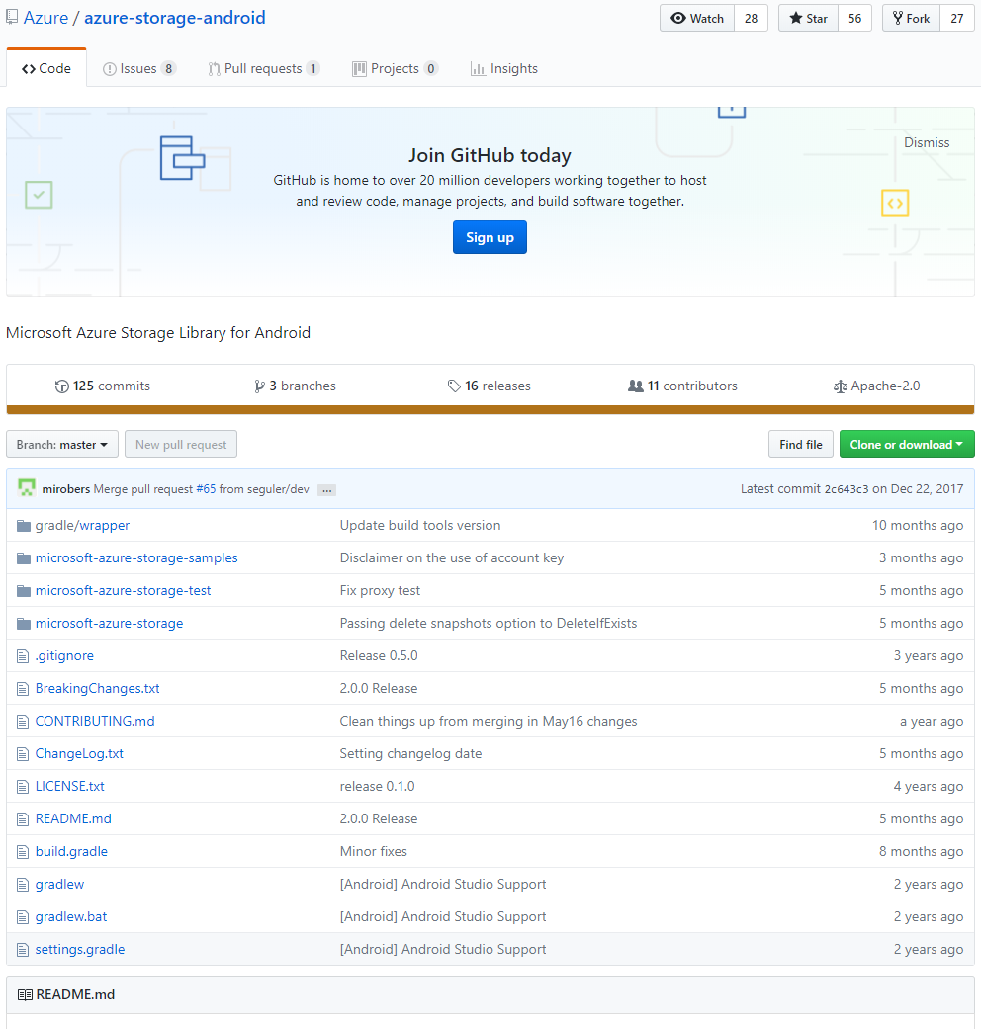
https://github.com/Azure/azure-storage-android

Slide 56

The way forward
Azure Table storage lives on (we hope!)
A need to get further support and new functionality
Lack of basic database operations is a problem
Ease of setup and use is a definite plus, that’s where Table storage shines

Slide 58
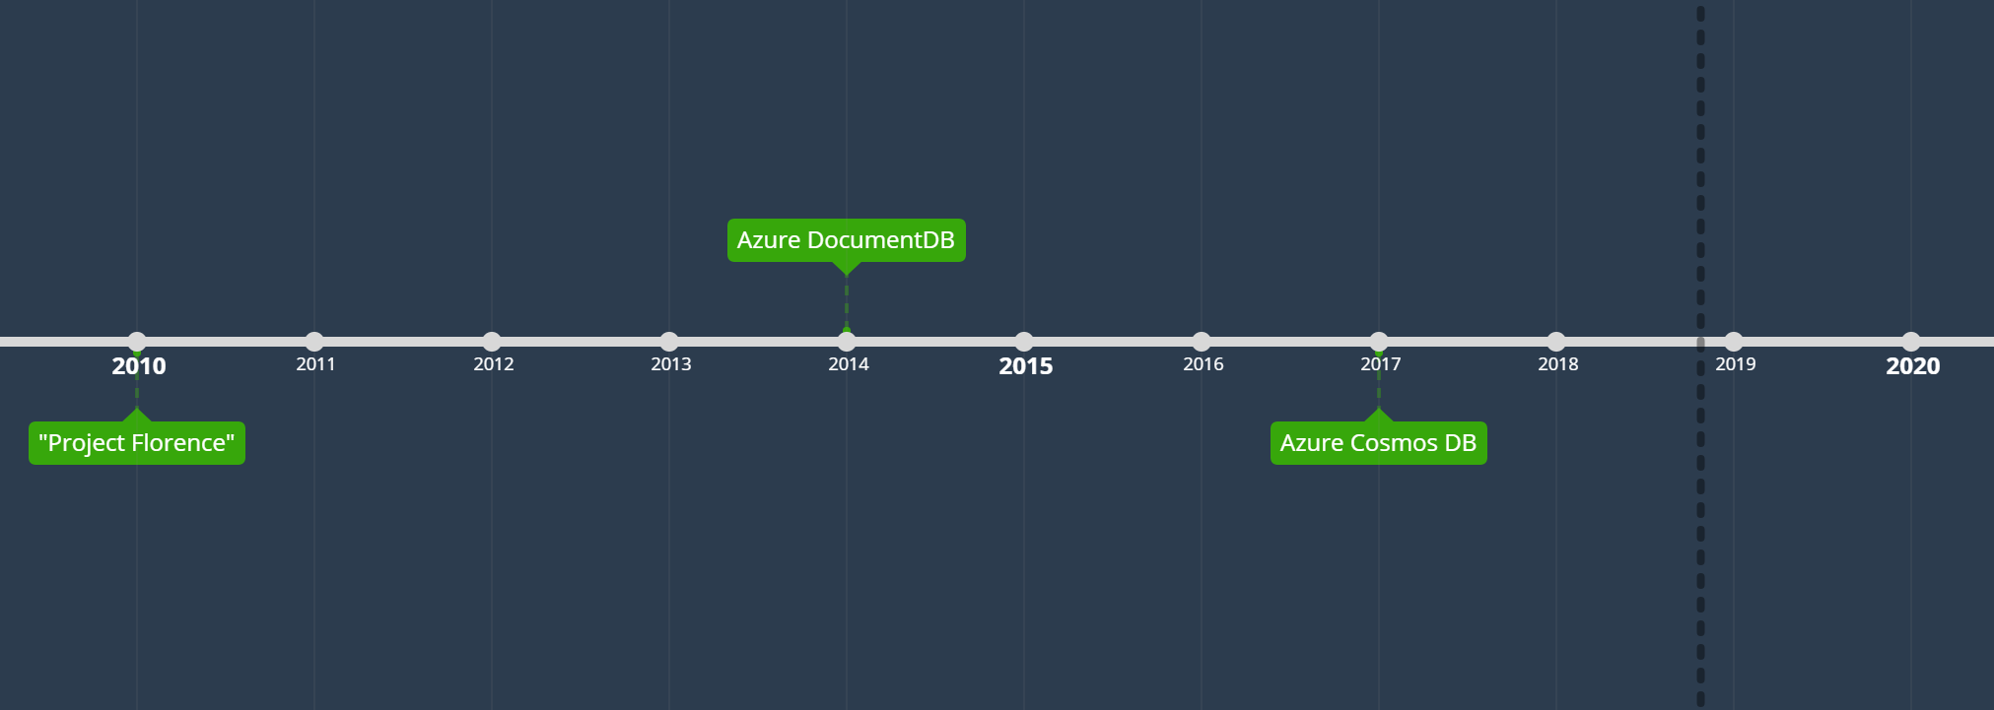

Slide 59
Decades of research and rigorous engineering

Slide 60
Global distribution
Elastic scalability of throughput and storage worldwide
Fine grained multi-tenancy
- Dharma Shukla, Founder of Azure Cosmos DB Microsoft
Notes:
Three fundamental properties of the cloud

Slide 61
99.999% write and read availability, all around the world

Slide 62
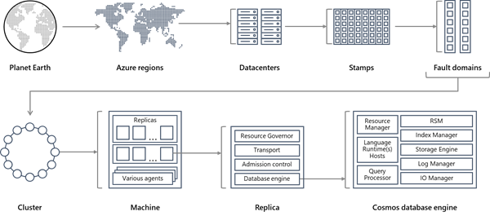
Figure credit: Microsoft.

Slide 63
Auto scaling of resources (memory, processor, partitions, replicas)
- Under 10 ms reads
- Under 15 ms writes
- Fetch 1 KB doc -> 1 RUs
- Delete, update, insert 1 KB doc -> 5 RUs
Easily tuned space
Consistency
- strong
- bounded-staleness
- session
- eventual

Slide 64
2016: Introduction of automatic partitioning
- Partitioned collections spanning multiple physical partitions with data, distributed by a partition key
- Automatic spreading of data depending on size and throughput
- Availability of data while it’s rebalanced across partitions
Automatic indexing
Embedded JavaScript engine
- Stored procedures
- Triggers
- User-defined functions (UDF), making up for limited SQL support

Slide 65
Supported environments

Slide 66








Slide 67
Querying

Slide 68
SQL-like query language matching JSON
LINQ
JavaScript integrated queries
MongoDB query language

Slide 69
Other features

Slide 70
Integration with Azure Blob Storage
GeoJSON support for geographical information

Slide 71
Real-world use cases

Slide 72
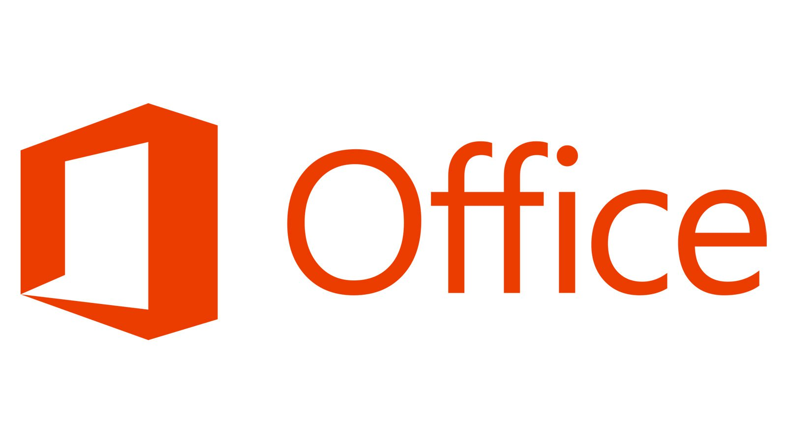
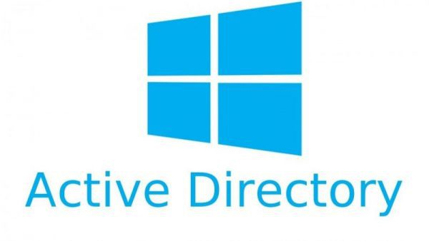




Slide 73
Limitations
Backup/restore
-Limited backup duration
LINQ queries not 100 % supported (yet)
Limited SQL
-No joins or aggregation
-No GROUP BY
«id» attribute not indexed
Only support for JSON

Slide 74
Cosmos DB and mobile
Excellent choice for mobile apps
Has everything a mobile developer needs
Global distribution makes data available everywhere for mobile users
First-class support for geospatial types, offering great geo-contextual experiences for mobile users

Slide 75
The way forward
Azure Cosmos DB paves the way for a great NoSQL future
Several limitations today but not a show stopper
High investment and full, continuous support from Microsoft forecasts a great future
High availability, cloud-based databases will continue to be the norm

Slide 76

Thanks!

